Slide 1
The Cool Code Consortium
7-26-2017
Notes:
Use this for Pro Audio Segments

Slide 2
Stuff
Cool Things
Cool News
Bluetooth
Next Week

Slide 3
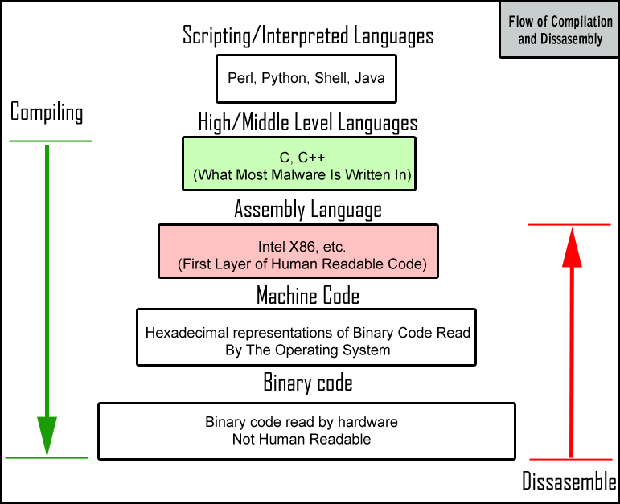

Slide 4
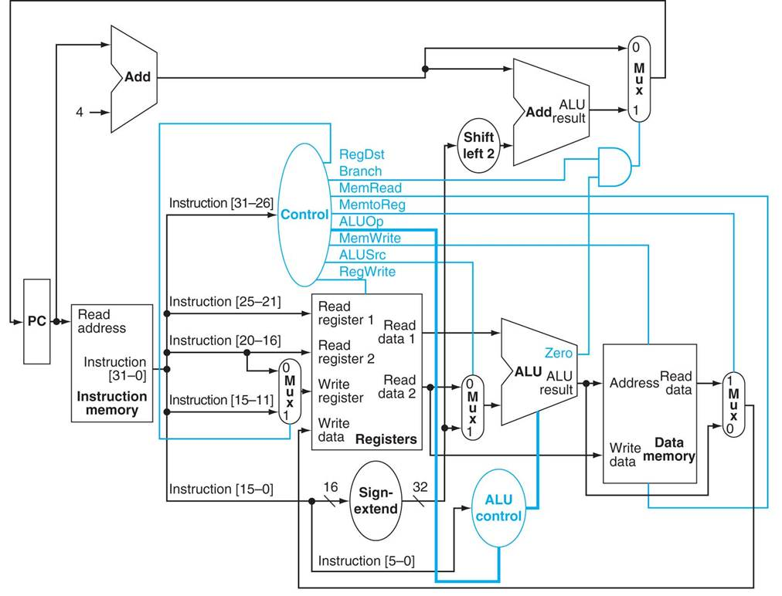

Slide 5
Cool Things
Facebook Group
Picture

Slide 6
Cool News
https://drive.google.com/open?id=1-gxJbD-vR7kMzOhXIbHClNbykFYBJoEUghpjwcN4XXM

Slide 7
Bluetooth

